Slide 1
Battery Packs
Chemistry Types
Design Considerations
Creation, Care and Charging of Packs
What Batteries Plus can do for you

Slide 2
Primary vs Secondary Battery
Primary
Not rechargeable
Typically more bang for the buck
Secondary
Rechargeable
More expensive
Limited cycle life

Slide 3
Secondary Battery Cell Chemistry
Lead Acid
Nickel/Cadmium
Nickel/Metal Hydrate
Lithium Polymer

Slide 4
Lead Acid(1859)
Pros
stable mature tech
low cost
long life cycle
ability to withstand mistreatment
wide temp range
high-drain applications
Cons
maintance
offgassing & corrosive effect if exceed 2.39 V(temperature dependent)
low energy densities
quick self discharge

Slide 5
Lead Acid Battery Basics
How they work;
Discharge - 2e
Pb + PbO₂ + 2 H₂SO₄ 2 PbSO₄ + 2 H₂O
Charge +2e

Slide 6
What Effects Performance?
Capacity: Measured in Amp Hours (AH) but based on discharge rate,
S-530
  530AH @ 100 Hr-rate (530AH/100H = 5.3A)
  or 400AH @ 20 Hr-rate (400AH /20H = 20A)
  Effected by:
  Density of oxide
  Temp (104% 40C, 75% -10C)
  Strength of acid (+5% for 15 points)

Slide 7
Peukert's law
Simply the law states that capacity decreases as discharge rate increases….
Does not factor in temp or self discharge rate.

Slide 8
25C = 77F

Slide 9
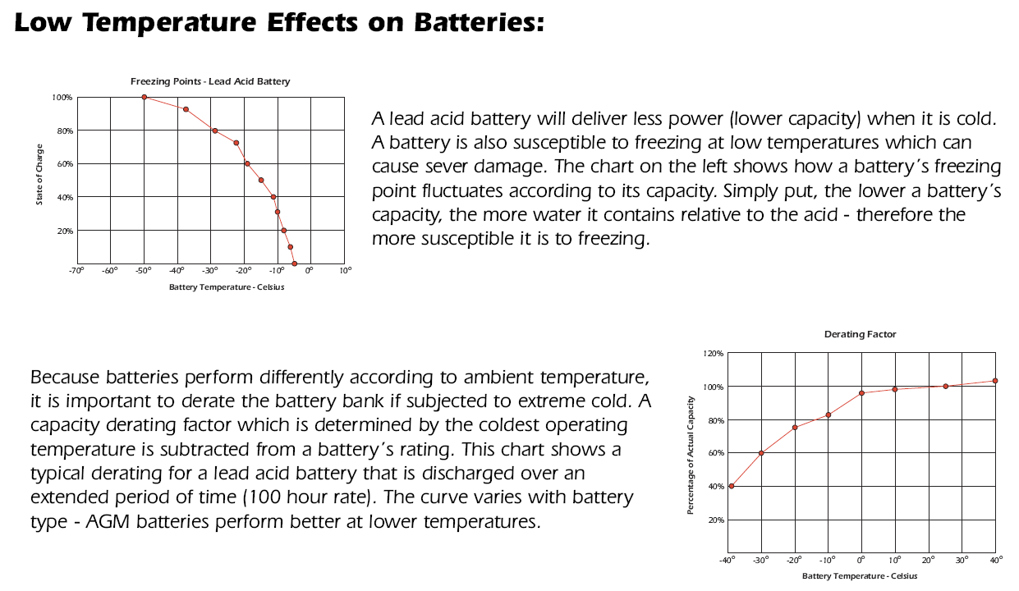

Slide 10
What Effects Performance?
Cycle-life / Durability
  Thickness of plates, matting, oxide density
Effected by:
  Depth of Discharge (DOD)
    Refers to amount of energy removed from the battery.

Slide 12
What Effects Performance?
Maintenance
  Liquid reserve
  Antimony %,
  Recombination / Condenser Caps,
Reliability
  Separator
  Welds & Post-burns
Notes:
Series 5000 have 3” of liquid reserve above the plates.
Lead Antimony results in more off gassing but offers longer life.
Hydrocaps / WaterMiser caps offer reduction in the frequency in checking the liquid levels – therefore reduced maintenance.
Enveloped separator eliminates premature failures due to shorted cells.
New robotic welding machine burns groups and posts upside down which eliminates the possibility of lead runs or foreign material within the cell.

Slide 13
State of Charge
SOC: Can be determined by measuring the weight of the acid (specific gravity) or voltage.
Concerns:
SG will lag on recharging due to mixing.
Voltage must be open circuit and rested.
Notes:
Answer to question 1 (C) – mention 1.265 specific gravity.

Slide 14
SOC – Specific Gravity
% Charged Specific Gravity
100% 1.255 – 1.275
75% 1.215 – 1.235
50% 1.200 – 1.180
25% 1.165 – 1.155
0% 1.130 – 1.110
Best gage of actual charge state of a flooded lead acid battery.

Slide 15
Charging Time
Determine bank size (530AH)
Estimate DOD (50%)
Calculate required AH (50% x 530AH = 265AH)
Compensate for charge inefficiency (265AH x 115% = 305AH)
Divide by charge rate (200AH / 25A = 12.2 Hrs)
Notes:
Answer to question 2. (C)
Write this equation on the board.
1000 x 50% = 500 AH
500 AH x 115% = 575 AH
575 AH / 100 = 5.75 hrs.

Slide 16
Voltage Settings
(Volts per cell) 12V 24V 48V
Equalization 2.58 -2.67(max) 15.5-16.0 31.0-32.0 61.9-64.1
Bulk 2.37-2.45 (max) 14.2-14.7 28.4-29.4 56.9-58.8
Absorption 2.37-2.45 (max) 14.2-14.7 28.4-29.4 56.9-58.8
Float 2.20-2.23 (max) 13.2-13.4 26.4-26.8 52.8-53.5

Slide 17
Charge Acceptance

Slide 19
Sulphation
Measure & record SG
Charge bank
  Note time to reach “Bulk Voltage”
Measure & record SG
  All low = sulphation problem
Equalize
  (2.58-2.67VPC)
Notes:
Answer to question 4. (C)
Describe how voltage reading will climb quickly and why this happens.

Slide 20
Sulphation Preventative Measures
Keep SG records
  Observe trends
Increase float voltage
Extend “Absorb time”
Get bank to 100%, once per month
  May require frequent equalization
Notes:
Answer to Question 5.
All of the above. (D)

Slide 21
Equalize Time
Determine bank size (1000AH)
Estimate DOD (20%)
Calculate required AH (20% x 1000AH = 200AH)
Compensate for charge inefficiency (200AH x 115% = 230AH)
Divide by charge rate (230AH / 50A = 4.6 Hrs)

Slide 22
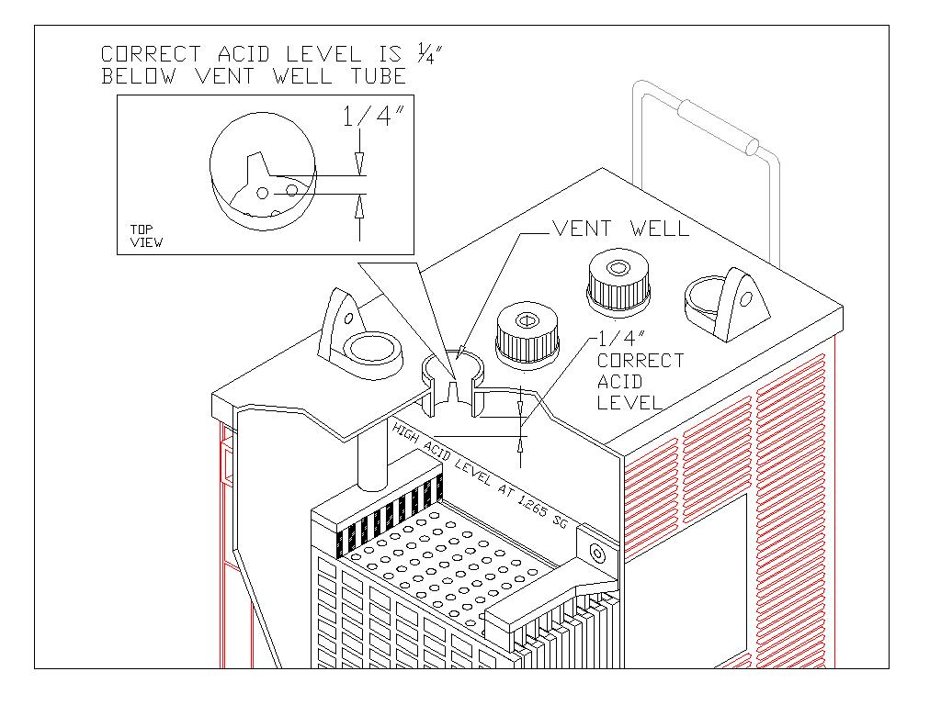
Correct Acid Level
Notes:
Answer to question 3. (C)

Slide 23
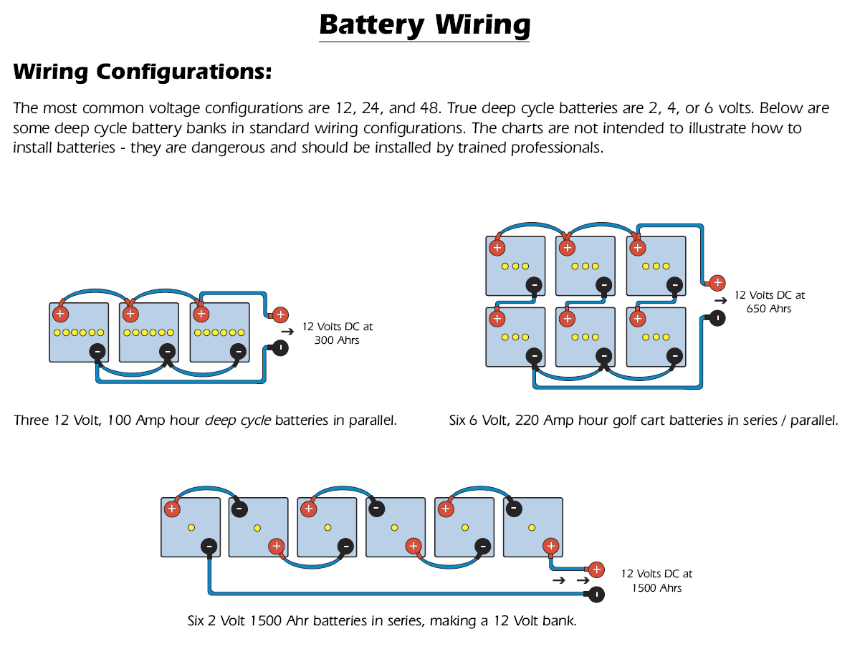

Slide 24
Nickel/Cadmium(1899)
Pros
good performance in high-discharge and low-temperature applications.
Low self discharge rate 1%/day.
Economical price
Mature stable tech
Cons
lower power densities
Toxic metals
Voltage depression

Slide 25
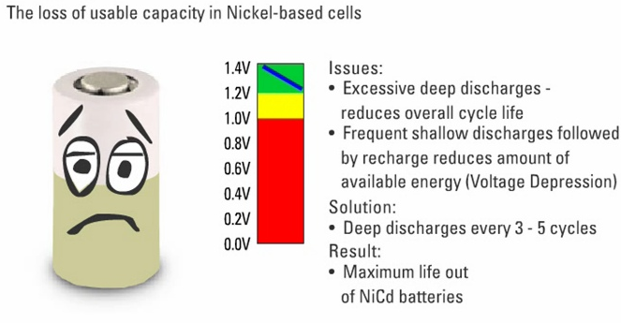
Voltage Depression in NiCad

Slide 26
Nickel/Metal Hydride (1990)
Pros
30% more capacity, increased power
Eco Friendly
Cons
cost more
half the service life of the NiCd cell

Slide 27
Lithium Ion(1999)
Pros
High energy density
Light weight
Cons
Expensive
Safety issues

Slide 28
Testing
Chemistry | Nominal Voltage | Fully charged voltage | Fully discharged voltage | Minimum charge voltage
NiMH | 1.2 V | 1.4 V | 1.0 V | 1.55 V
NiCad | 1.2 V | 1.4 V | 1.0 V | 1.50 V
Lead Acid | 2.0 V | 2.1 V | 1.75 V | 2.3 - 2.35 V
Lithium | 3.6 V | 3.7 V | 3.0 V | 4.2V

Slide 29
Geometry and Topology Considerations for Assembling Batteries

Slide 30


Ladder, linear, F type, or radial
Size of a ladder pack is D x nD x H where D is the diameter of the cell, n is the number of cells, and H is the height of the cells.

Slide 31

Multi-row cells
Size of such a pack is nD x mD x H, where n is the number of cells in a row, m is the number of rows, D is the cell diameter, and H is the cell height.

Slide 32
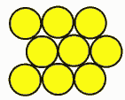
Face centered "cubic"
Size is L x W x H where
L = (n +½)D
W = [0.866(p-1)+1] D
H=H
p is the number of rows wide.

Slide 33

Linear, or L-type, or Axial
Stack of cells end to end. Easiest pack to build. Weld cells side by side and then bend over.

Slide 34
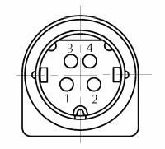
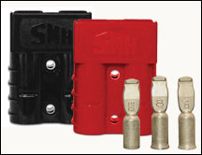
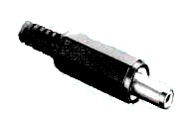
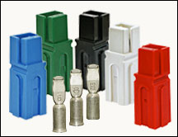
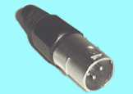

Connectors
Mini-Din
Anderson
SY
Pin and Barrel
XLR
Adapter to Screw

Slide 35
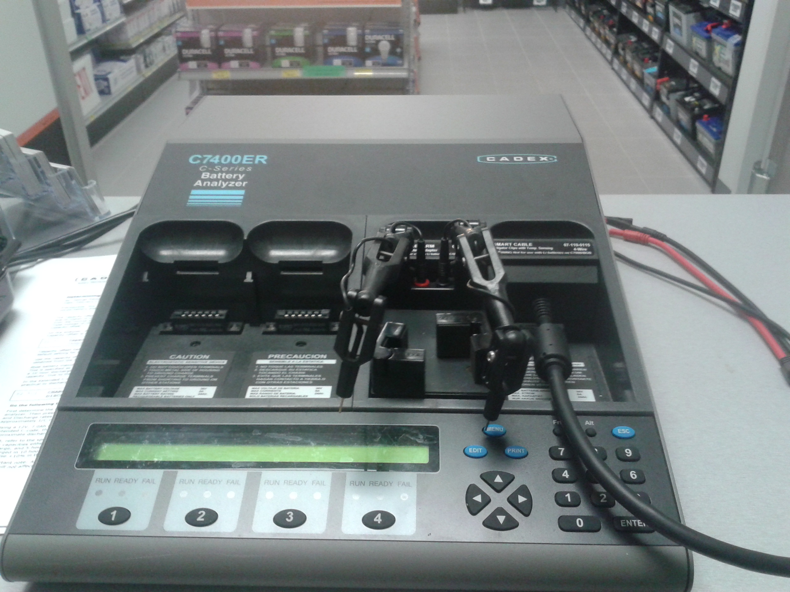
Tools to build packs
Cadex = Awesome Battery Tool
Charge
Wakeup
Prime
Cycle Life
Boost
Runtime
Ohm Test
Self Discharge

Slide 36
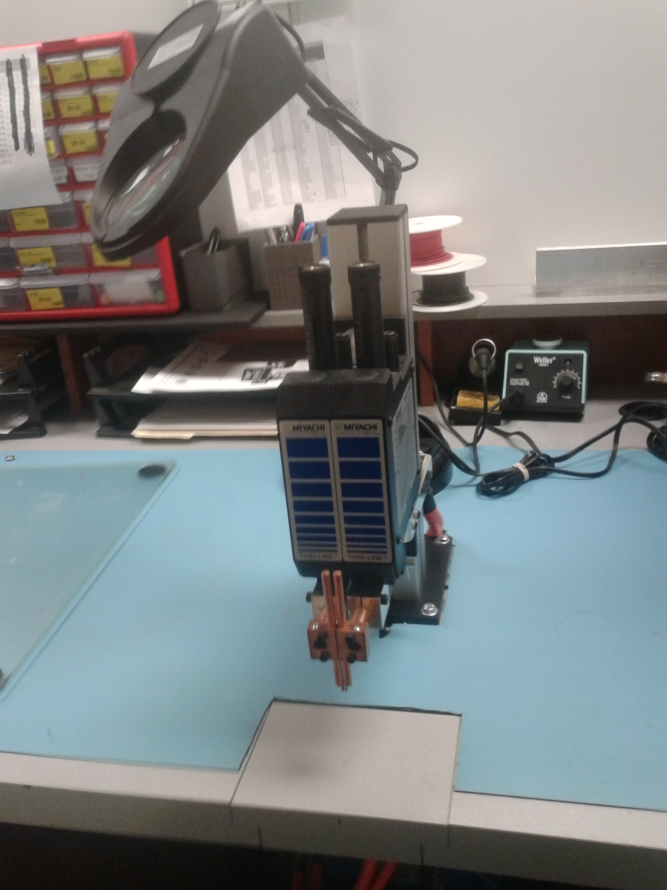
Pack Welder
Dual Pulse Spot Welder
1st Cleans and conditions
2nd Pulse Welds
Benefits
Low heat transfer
Perfect Welds every time

Slide 37
OEM Battery Packs/Tech Center
Provide engineered solutions to build custom battery packs
Each store is equipped with a Tech Center
Design and build the most efficient battery using chemistry, capacity and configuration
On-site needs analysis
Testing, charging, analyzing & reconditioning
Skilled technicians for consultation
Rebuilding
Large-run contract manufacturing

